Slide 1
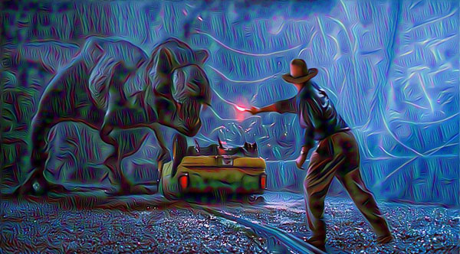
Neural Artistic Style Transfer Exploration
Sudeshna Dasgupta
18BCB0016

Slide 2
Contents:
Abstract
Introduction
Literature Review
Proposed Method
Results
Conclusion
References

Slide 3
Abstract:
Neural Style Transfer (NST) is a class of software algorithms that manipulates digital videos and images, to adopt the appearance or visual style of another video or image.
Neural Style Transfer algorithms use deep neural networks to perform image transformation.
NST is an optimization based computer vision technique that allows us to manipulate and thus recompose an image’s content in another image’s style.
It takes 2 images—a content image and a style image for reference and blends both of them together to get an output image, thereby making it appear as if it’s been painted in the style of the style image, in spite of retaining the core elements of the content image.

Slide 4
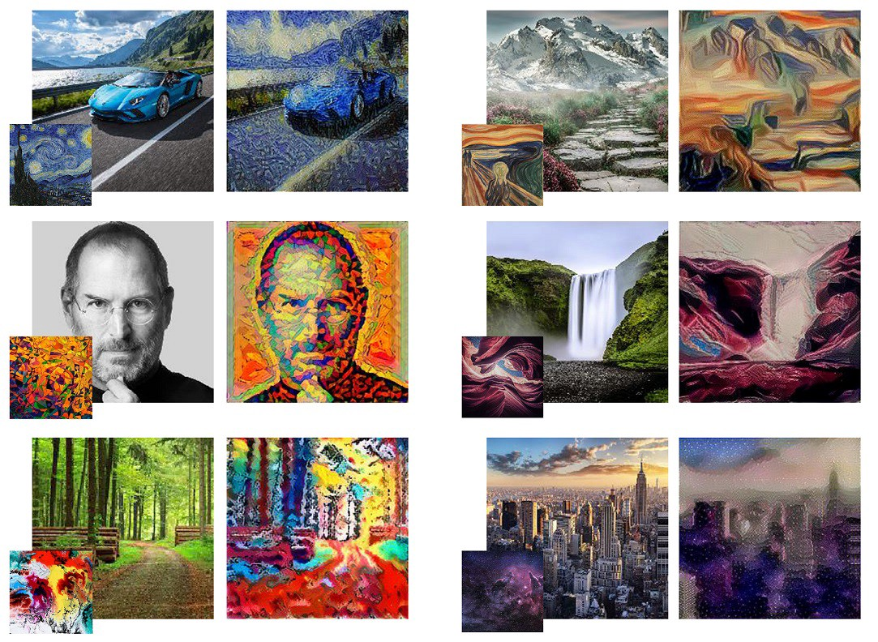
Fig.1 – Examples of results of Neural Style Tramsfer

Slide 5
Introduction
NST defines the following inputs:
A generated image — the image that contains the final output which is the only trainable variable
A style image — the image from which we want to transfer the style that is to be incorporated in the content image
A content image — the image on which we want to perform the style transfer

Slide 6
How does neural artistic style transfer work?
We take an input image and a style image and then resize them to equal dimensions.
Then we load a pre-trained Convolutional Neural Network (CNN) such as VGG19.
We can distinguish layers of the CNN that are the responsible for the content (image-specific features) and layers which are responsible for style (basic shapes, colours etc.), we can separate the different layers of the CNN to independently work on the style and content.
Next we have to work on the optimization problem using which we try to minimize:
Content loss (distance between the output and input images - we strive to preserve the content)
Style loss (distance between the output and style images - we strive to apply a new style)
Total variation loss (regularisation - spatial smoothness to de-noise the output image)
5. Set the gradients and perform optimization.

Slide 7
I have made use of the L-BFGS optimization algorithm (Limited-memory Broyden–Fletcher–Goldfarb–Shanno algorithm), which is generally used in machine learning for parameter estimation.
NST uses a pre-trained convolution neural network (CNN) to transfer styles from a given image to another. This is done by defining a loss function that tries to minimise the differences between a style image and a content image, by blending them both seamlessly together to create a generated image.
Two networks namely, a pre-trained feature extractor and a transfer network are required to train a style transfer model.
Style transfer runs the two images through a pre-trained NN where it compares the similarity of the pre-trained network’s output at multiple different layers.
Images producing similar output at one of the pre-trained model’s layers most likely has similar content while having a similar style with matching output at another layer.
The transfer network has an encoder-decoder architecture which helps us to create the stylized image since the pre-trained model only which lets us compare the content and style of both the images.

Slide 8
Literature Review
In 2015, Gatys et al. introduced an artificial system based on a Deep Neural Network that creates artistic images of high perceptual quality. The system used neural representations to separate and recombine content and style of arbitrary images, providing a neural algorithm for the creation of artistic images. Their work offered a path forward to an algorithmic understanding of how humans create and perceive artistic imagery.
In 2017, Vincent Dumoulin & Jonathon Shlens & Manjunath Kudlur investigated the construction of a single, scalable deep network that can parsimoniously capture the artistic style of a diversity of paintings. They demonstrated that such a network generalizes across a diversity of artistic styles by reducing a painting to a point in an embedding space and this model also permits a user to explore new painting styles by arbitrarily combining the styles learned from individual paintings.

Slide 9
In 2016, Dmitry Ulyanov, Andrea Vedaldi, Victor Lempitsky showed how a small change in the stylization architecture resulted in a significant qualitative improvement in the generated images. The change was limited to swapping batch normalization with instance normalization, and to apply the latter both at training and testing times. The resulting method could be used to train high-performance architectures for real-time image generation.
In 2017, Xun Huang, Serge Belongie presented a simple yet effective approach that enabled arbitrary style transfer in real-time for the first time. They used adaptive instance normalization (AdaIN) layer to align the mean and variance of the content features with those of the style features and achieved speed comparable to the fastest existing approach, without the restriction to a pre-defined set of styles. Their approach also allowed flexible user controls such as content-style trade-off, style interpolation, color & spatial controls, all using a single feed-forward neural network.

Slide 10
In 2017, Fujun Luan, Sylvain Paris, Eli Shechtman, Kavita Bala introduced a deep-learning approach to photographic style transfer that handles a large variety of image content while faithfully transferring the reference style. Their approach successfully suppressed distortion and yielded satisfying photorealistic style transfers in a broad variety of scenarios, including transfer of the time of day, weather, season, and artistic edits.
In 2017, Golnaz Ghiasi, Honglak Lee, Manjunath Kudlur, Vincent Dumoulin, Jonathon Shlens presented a method which combined the flexibility of the neural algorithm of artistic style with the speed of fast style transfer networks to allow real-time stylization using any content/style image pair. Their model successfully trained on a corpus of roughly 80,000 paintings and was able to generalize to paintings previously unobserved. They demonstrated that the learned embedding space is smooth and contained a rich structure and organizeed semantic information associated with paintings in an entirely unsupervised manner.

Slide 11
Proposed Method:
Neural Artistic Style Transfer model consists of two sub-models:
Style Transform Model is a neural network that creates a stylised image after taking an image and then applying a style bottleneck vector to the content image.
Style Prediction Model is a neural network that takes a style image as input to a 100-dimension style bottleneck vector.
Model Used: VGG network features and implementation
VGG19 network was developed during The ImageNet Large Scale Visual Recognition Challenge (ILSVRC)-2014, for image classification, with an error rate of 7.3%. VGG-19 is a 19-layer deep convolutional neural network. We can download a pre-trained network version of over a million images from the ImageNet database. A pre-trained network can classify images into 1000 objects, such as a keyboard, mouse, pencil, and many more animals. As a result, the network has read rich presentations of various images. The network has 224-by-224 image input size. We can use the split to separate new images using the VGG-19 network.

Slide 12
VGG network
As suggested in the paper by Gatys et al., I’ve used VGG19 network for this project.
VGG19 network, a 19 layers deep CNN, is widely used for Neural Artistic Style transfer and has been trained on a million images (approximately) from ImageNet database, due to which it has the ability to detect high-level features in an image.
The ‘encoding nature’ of CNNs is the key in Neural Artistic Style Transfer. Our first step will be the initialization of a noisy image, which is later going to be our generated or output image (G).
Second step is the calculation of the similarity of this image to the style and the content image at any particular given layer of our VGG19 network.
We calculate the loss of output/generated image (G) with respect to the content(C) and style(S) image because we want our output/generated image (G) to have the content and style of the content image(C) and style image(S) respectively.

Slide 13
VGG19 lets us extract the feature maps and the style and content representations of the style, content, and the generated images.
VGG19 is a relatively simple model of CNN as compared to Inception and ResNet. VGG19’s feature maps work better for neural artistic style transfer. VGG19 has 5 stacks of convolutional layers- conv1 to conv5, each possessing 2 to 4 layers called conv1_2…conv5_4, which are in turn followed by fully connected layers that are actually performing the classification.
The convolutional layers perform feature extraction by finding various geometrical shapes and patterns of progressing complexity while the fully connected layers act as a perceptron and classifies objects based on the shapes that are present in the image.
A pre-trained VGG network with detached completely convolutional layers will act as a pure pattern and feature extractor.

Slide 14
VGG Network Implementation
In order to find both the content and style of our image, we will look at some of the inner layers within our model.
The middle layers represent the feature maps that start to get more organized as you go deeper.
These middle layers are needed to define content and style representation from our images.
We will try to match the corresponding style styles and content to these intermediate layers with the installation image.
We will download our pre-trained photo editing network. After that, we hold the layers of interest.
We then describe the Model by setting the model input into the image and the effects of the style and content output.
In other words, we have created a model that will take the image of the insert and extract the content and style of the middle layers.

Slide 15
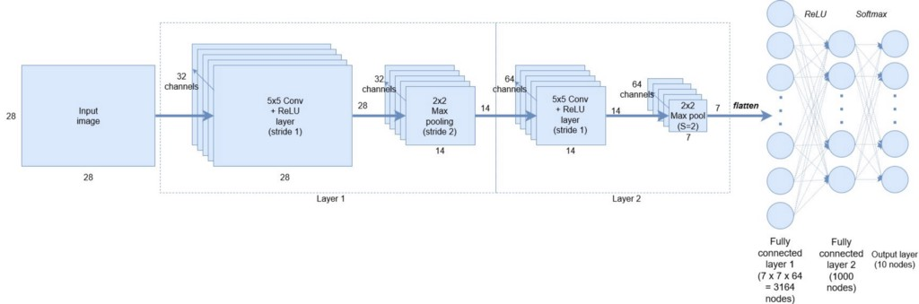
Fig.2 - Convolutional Neural Network Architecture
In Fig 1, the 1st Layer, using 32 filters, the convoluted neural network (CNN) can capture simple patterns, for example, a horizontal line or a straight line, which might not make any sense to us but is of great importance to the CNN. Slowly upon moving down to the 2nd Layer, having 64 filters, CNN starts capturing more and more complex features that it couldn’t by using its previous layer. It might be the face of a cat or dog or human or an inanimate object. Feature Representation is the process of capturing of different simple and complex features. The important thing to note here is that CNNs in spite of not knowing what a particular image is can learn to encode what that image is representing. Convolutional Neural Networks (CNNs)’s encoding nature helps us in Neural Artistic Style Transfer.

Slide 16
Content Loss
Content Loss is a function representing a weighted version of the content distance for an individual layer. We are going to add the content loss module directly after the convolution layers that are being used to compute the content distance. In this way every time the convoluted neural network is fed with an input image, the content losses will get computed at the respective desired layers and because of auto grad, all the gradients will get computed. In order to make the content loss layer transparent, we are required to define a forward method that will compute the content loss and then return the layer’s input. The computed loss will be saved as a parameter of the module.
Style Loss
Implementation of the Style Loss module is very similar to that of the Content Loss module. It acts as a transparent layer in a network computing the style loss of that particular layer. We need to compute the gram matrix to calculate the style loss. A gram matrix is a result of multiplying a given matrix by its own transpose.
The gram matrix must be normalized by dividing each of its element by the total number of elements present in the matrix. Normalization of larger values in the Gram matrix is important else they will cause the first layers, that are present before pooling layers, to have a larger impact during the gradient descent. Style features tend to be in the deeper layers of the convoluted neural network so this step of normalization is really important.

Slide 17
Importing the Model
We will be importing a pre-trained neural network. I have used a 19 layer VGG network. PyTorch’s implementation of VGG is a module that divides into 2 child Sequential modules, Features that contains convolution and pooling layers, and Classifier that contains fully connected layers. We need the output of the individual convolution layers to measure content and style loss so we will be using the features module.
Gradient Descent
I have used the L-BFGS algorithm to run gradient descent. I want to train the input image in order to minimize the content/style losses, unlike training a network. So I'm going to create a PyTorch L-BFGS optimizer optim.LBFGS and pass the input image to it as the tensor to be optimized.
Limited-memory BFGS
L-BFGS or LM-BFGS is basically an optimization algorithm that uses a limited amount of computer memory to approximate the Broyden–Fletcher–Goldfarb–Shanno algorithm (BFGS). L-BFGS algorithm is widely known for parameter estimation in the domain of machine learning.

Slide 18
Algorithm & Architecture Discussion: According to the paper published by Gatys et al in 2015, it is possible to separate the Style and the Content of an image, thereby, making it possible to combine the style and the content of different images. Gatys made use of a 19 layers deep Convolutional Neural Network (CNN), called VGG-19 (VGG - Visual Geometric Group), with 16 CONV layers and 3 FC layers. Stanford University’s Standford Vision Lab pre-trained VGG-19 on the ImageNet dataset. Gatys performed average pooling without the use of any FC layers. Pooling reduces the spatial volume of feature vectors, thereby, reducing the number of computations.
Optimizing the loss
To minimize the loss, I’ll be using the optimization algorithm, L-BFGS optimizer because for the given task at hand (Neural Artistic Style Transfer), the L-BFGS optimizer is faster in learning in comparison to the Adam Optimizer. Using Stochastic Gradient Descent or Adam Optimizer is not recommended in this case because the data used here is not Stochastic i.e. dividing the dataset into smaller mini-batches won’t work because here we are giving a single static image as the input.

Slide 19
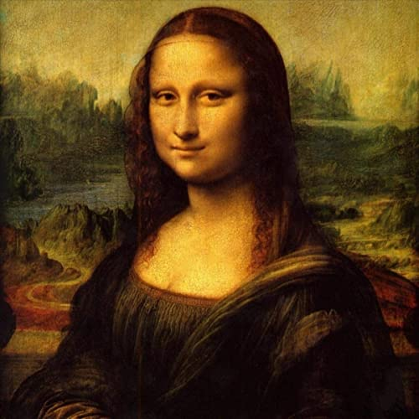
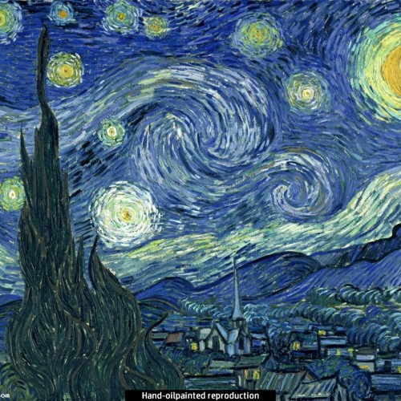
Results
Fig.1 - Content Image
Fig.2 - Style Image

Slide 20
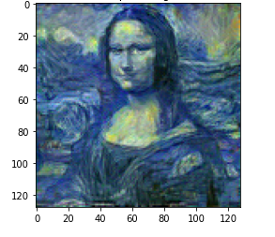
Fig.6 – Output Image

Slide 21
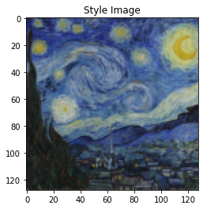
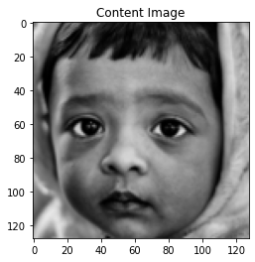
Fig.4 - Style Image
Fig.5 - Content Image

Slide 22
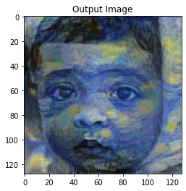
Fig.6 - Output Image

Slide 23
Conclusion
Successfully understood the need of neural style transfer and gave an overview of the architecture of the methodology followed.
Defined the specifics of the neural style transfer network using TensorFlow.
Defined several functions that were used to define the variables/inputs, compute the VGG19 output, compute the losses and perform the optimisation.
Understood the concept of content loss and the style loss in detail, and saw how they defined the final loss together.
During the course of this project, I learnt how to build several different loss functions and then how to use back propagation to minimize the losses and transform the input images.
Loaded a pre-trained CNN model – VGG19 and used its feature maps to describe the style and content representation of the images.

Slide 24
The loss functions defined in the code mainly compute the distance in terms of style and content representations of the images.
Learnt how to work dynamically with tensors and manipulate them directly, thus making debugging and working with tensors considerably easier by using a natural python control flow.
Finally ran the custom model after the successful implementation of the above concepts and generated the output artwork by the model.
Using the command tf.gradient and by applying optimizers update rules, iteratively updated the image.
The L-BFGS algorithm based optimizer minimized the given losses with respect to the input image.

Slide 25
Future Implementation: Real-world applications for style transfer:
Photo and video editors
Commercial art
Neural Artistic Style Transfer on mobile
Gaming
Virtual reality

Slide 26
References
[1508.06576] A Neural Algorithm of Artistic Style
[1705.04058] Neural Style Transfer: A Review
[1703.07511] Deep Photo Style Transfer
[1611.07865] Controlling Perceptual Factors in Neural Style Transfer
[1607.08022] Instance Normalization: The Missing Ingredient for Fast Stylization
[1603.08155] Perceptual Losses for Real-Time Style Transfer and Super-Resolution
[1703.06868] Arbitrary Style Transfer in Real-time with Adaptive Instance Normalization
[1705.06830] Exploring the structure of a real-time, arbitrary neural artistic stylization network
[1610.07629] A Learned Representation For Artistic Style
[1606.05897] Preserving Color in Neural Artistic Style Transfer

Slide 27
Thank you!

